Slide 1


Sangeet R. Shrestha
03-08-2024

Slide 2

Outline
Executive Summary
Introduction
Methodology
Results
Conclusion
Appendix

Slide 3
Executive Summary
Summary of methodologies
Data Collection: SpaceX API and Scraping other Web sources.
Exploratory Data Analytics (EDA): Data Wrangling, Data Visualization, Interactive Visual Analytics.
Machine Learning Predictions through multiple classification models.
Summary of all results
Multiple public sources, including SpaceX API, were scraped for necessary data.
Feature identification, refinement, and relationship between dependent and independent variables were established through thorough EDA.
Machine Learning Predictions helped choose the best model, based on accuracy score, to predict outcome based on most relevant characteristics/features.

Slide 4
Introduction
We aim to evaluate the likelihood of Space Y being competitive to Space X. We aim to do so by predicting the likely cost of a launch based on multiple independent variables.
Problems we aim to find answers to:
The likelihood of the first stage landing and the best prediction to the associated cost.
The best location for a launch based on the likelihood of a successful landing.

Slide 5

Section 1

Slide 6
Methodology
Executive Summary
Data collection methodology:
2 Primary Sources of data were used:
Space X API at https://api.spacexdata.com/v4/rockets/
Web Scraping at https://en.Wikipedia.org/wiki/List_of_Falcon/_9/_and_Falcon_Heavy_launches
Performed data wrangling
Feature engineering was done on collected data to create numeric equivalence of categorical data based on landing outcome. Features were also summarized after EDA to better prepare for the prediction model.
Performed exploratory data analysis (EDA) using visualization and SQL
Performed interactive visual analytics using Folium and Plotly Dash
Performed predictive analysis using classification models
The normalized dataset was divided into training and testing data. It was then fitted to 4 different classification models based and evaluated based on their accuracy using different combination of parameters through GridSearchCV.

Slide 7
Data Collection
2 Primary Sources of data were used:
Space X API at https://api.spacexdata.com/v4/rockets/
Web Scraping at https://en.Wikipedia.org/wiki/List_of_Falcon/_9/_and_Falcon_Heavy_launches

Slide 8
Data Collection – SpaceX API
SpaceX REST API:
This API gives us data about launches, including information about the rocket used, payload delivered, launch specifications, landing specifications, and landing outcome.
Our goal is to use this data to predict whether SpaceX will attempt to land a rocket or not.
The flowchart, herewith, shows the data collection process.
https://github.com/Sangeetrajshrestha/appliedDSFinal/blob/d44cb4d8a7e516f9fac5224cc85e56f7e1ccaec9/spacex-data-collection-api.ipynb
Request SpaceX API for launch data
Parse and Filter Data to only include the Falcon 9 Launches
Data Wrangling for Missing Values and Irregularities

Slide 9
Data Collection - Scraping
Web Scraping Falcon 9 Launch Wiki Page
A popular source for web scraping launch data.
Used the Python BeautifulSoup package to web scrape some HTML tables that contain valuable Falcon 9 launch records.
Parsed the data from the tables and convert them into a Pandas data frame for further analysis
https://github.com/Sangeetrajshrestha/appliedDSFinal/blob/e86b327c40dc7c9f7bc07e283cd59eb547335c39/webscraping.ipynb
Scrape Falcon 9 Launch Wiki page for launch data
Extract all required columns from acquired table data.
Create a data frame and perform data wrangling and analysis.

Slide 10
Data Wrangling
The data was thoroughly studied for the viability, structure, and context using SQL. This consisted of understanding the variables and their coherence to our study.
Exploratory Data Analysis (EDA) was performed using Python libraries:
We attempt to understand the relationships between the different independent and dependent variables; visually and otherwise.
We analyze the launches, study the occurrences of orbits, and mission outcome per orbit and summarize the findings.
We perform feature engineering to label the landing outcome to prepare the dataset for the classification model.
https://github.com/Sangeetrajshrestha/appliedDSFinal/blob/d44cb4d8a7e516f9fac5224cc85e56f7e1ccaec9/spacex-Data%20wrangling.ipynb
EDA
Establish Relationship and Summarize
Feature Engineering

Slide 11
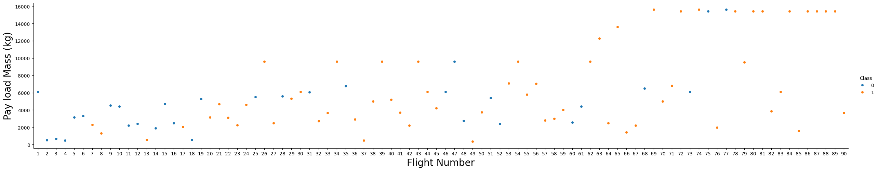
EDA with Data Visualization
Different plots were utilized to establish existing relationship between the variables in the dataset. These include scatterplots, bar plots, and line plots.
Payload Mass (kg) by Flight Number
We studied the following relationships through visualizations:
Payload Mass by Flight Number, Launch Site by Flight Number, Payload Mass by Launch Site, Success Rate by Orbit, Orbit by Flight Number, and Success by Date.
https://github.com/Sangeetrajshrestha/appliedDSFinal/blob/e86b327c40dc7c9f7bc07e283cd59eb547335c39/EDA%20with%20Pandas%20And%20Seaborn.ipynb

Slide 12
EDA with SQL
Following data points were studied through SQL queries for further exploration:
Names of the unique launch sites in the space mission.
Records of where launch sites began with string ‘CCA’.
Total payload mass carried by boosters launched by NASA (CRS)
Average payload mass carried by booster version F9 v1.1
Date when the first successful landing outcome in ground pad was achieved.
Names of the boosters which have success in drone ship and have payload mass greater than 4000 but less than 6000.
Total number of successful and failure mission outcomes.
Names of the bosster_versions which have carried the maximum payload mass, using a subquery.
Records for 2015 displaying the months, failure landing_outcomes in drone ship, booster versions, and launch_site.
Rank of landing outcomes counts between 06/04/2010 and 03/20/2017.
https://github.com/Sangeetrajshrestha/appliedDSFinal/blob/e86b327c40dc7c9f7bc07e283cd59eb547335c39/EDA%20with%20SQL%20FInal.ipynb

Slide 13
Build an Interactive Map with Folium
Folium Maps library was used with Markers, circles, lines, and marker clusters.
Markers are used to indicate launch site points.
Circles are used to highlight areas around specific coordinates.
Marker Clusters are used to indicate groups of events in each point of interest (viz. launch sites)
Lines are used to mark the distance between two coordinates.
https://github.com/Sangeetrajshrestha/appliedDSFinal/blob/e86b327c40dc7c9f7bc07e283cd59eb547335c39/folium%20lab%20launch%20site.ipynb

Slide 14
Build a Dashboard with Plotly Dash
The data was also studied through interactive dashboards built using Plotly Dash.
The following graphs and plots were utilized to visualize the data:
Percentage of launches by site
Payload Range
These plots help us quickly understand the relation between payloads and launch sites. This aides in identifying the best place to launch based on payload.
https://github.com/Sangeetrajshrestha/appliedDSFinal/blob/e86b327c40dc7c9f7bc07e283cd59eb547335c39/spacex_dash_app.py

Slide 15
Predictive Analysis (Classification)
The dataset was first split into two categories each of training and testing data.
Four classification models were built, evaluated, and improved for predictive analysis. The models were instantiated, and first the training data was fit to the models after applying the GridSearchCV to identify the best parameters.
Then, the accuracy score was obtained using the testing dataset.
Finally, the best performing classification model was picked based on the accuracy score of each model.
https://github.com/Sangeetrajshrestha/appliedDSFinal/blob/e86b327c40dc7c9f7bc07e283cd59eb547335c39/SpaceX_Machine_Learning_Prediction_Part_5%20-%20Final.jupyterlite%20copy.ipynb
Data Preparation and Train/Test Split
Model Creation and Parameters Tests
Comparison of Results for Best Model Accuracy

Slide 16
Results
Exploratory data analysis results:
There 4 different launch sites used by Space X: CCAFS LC-40, VAFB SLC-4E, KSC LC-39A, CCAFS SLC-40
The first launches were done in collaboration between Space X and NASA.
The total payload mass carried by boosters launched by NASA (CRS) was 45596 kg.
The average payload of F9 v1.1 booster is 2,928.4 kg.
The first successful landing outcome in ground pad was achieved in 12/22/2015.
Many Falcon 9 booster versions have success in drone ship landing with a payload mass between 4000 kg and 6000 kg; with a high success rate.
Different versions of Falcon B5 boosters have carried the maximum payload mass.
The successful landing outcomes have become significantly better over time.

Slide 17
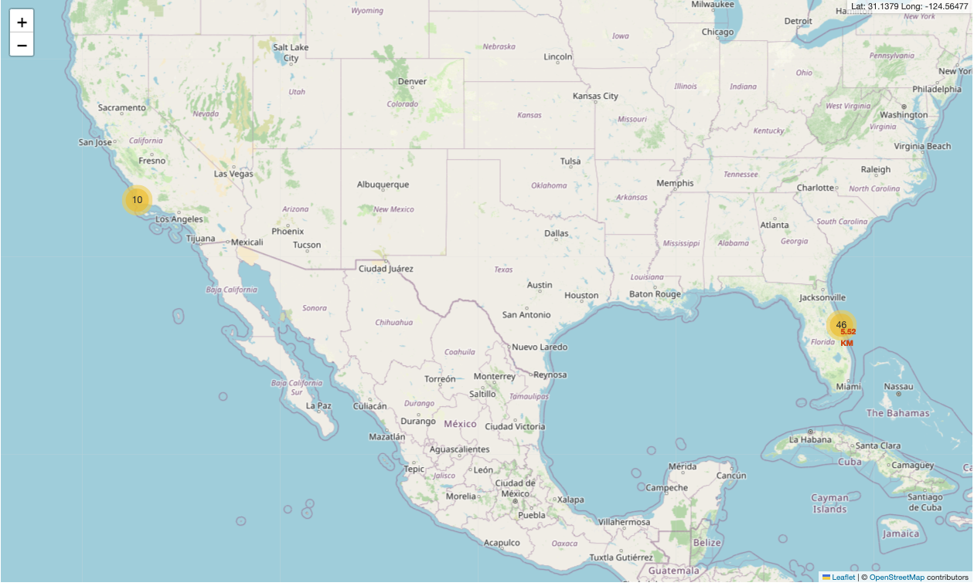
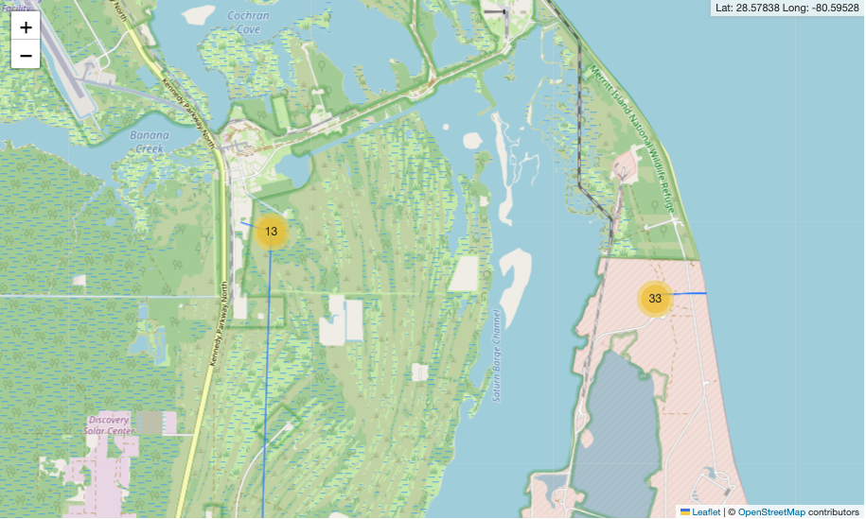
Results
Launch Sites are concentrated in the coastal regions (California – West, and Florida – East); with majority of the launches from the east coast.
Using interactive maps made it possible to identify characteristics of launch sites. This includes the distance from sea, infrastructures, etc.
US Launch Sites, West vs East Coast
Concentration of Launch Sites on the East Coast

Slide 18
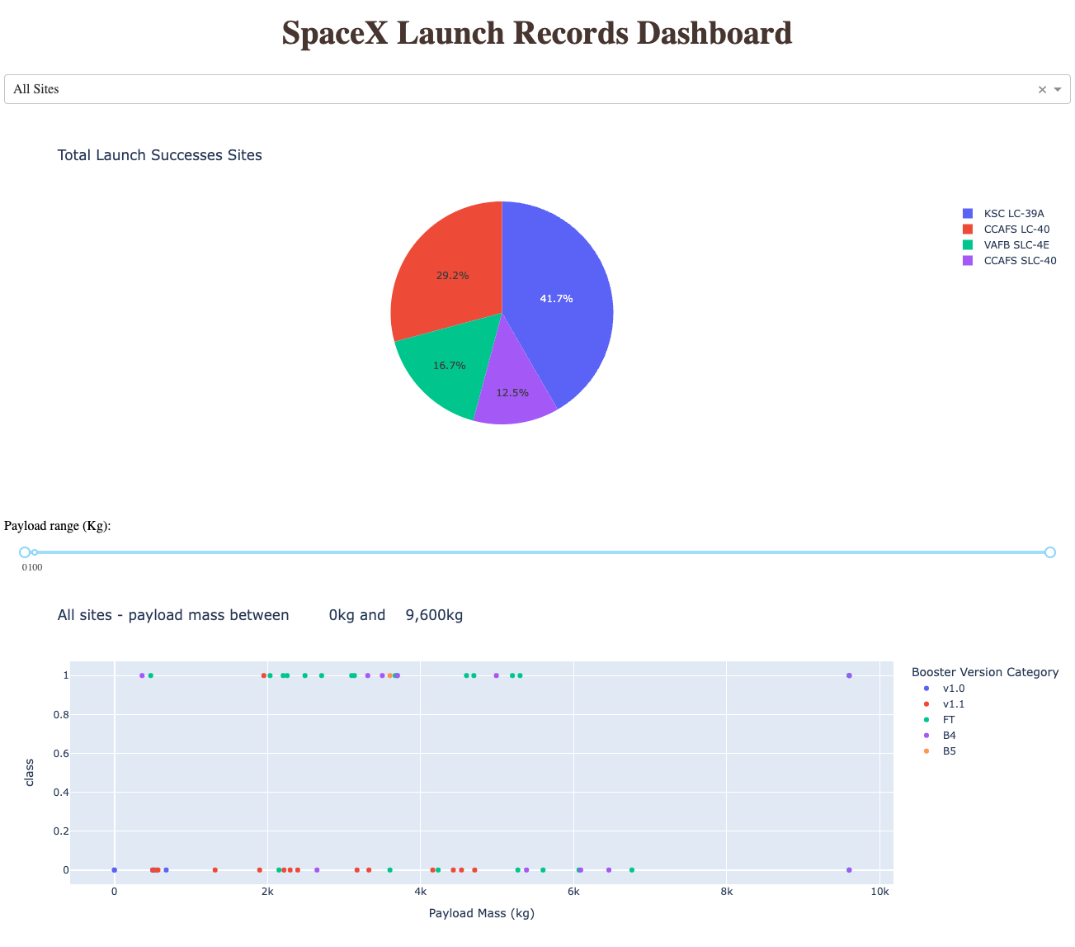
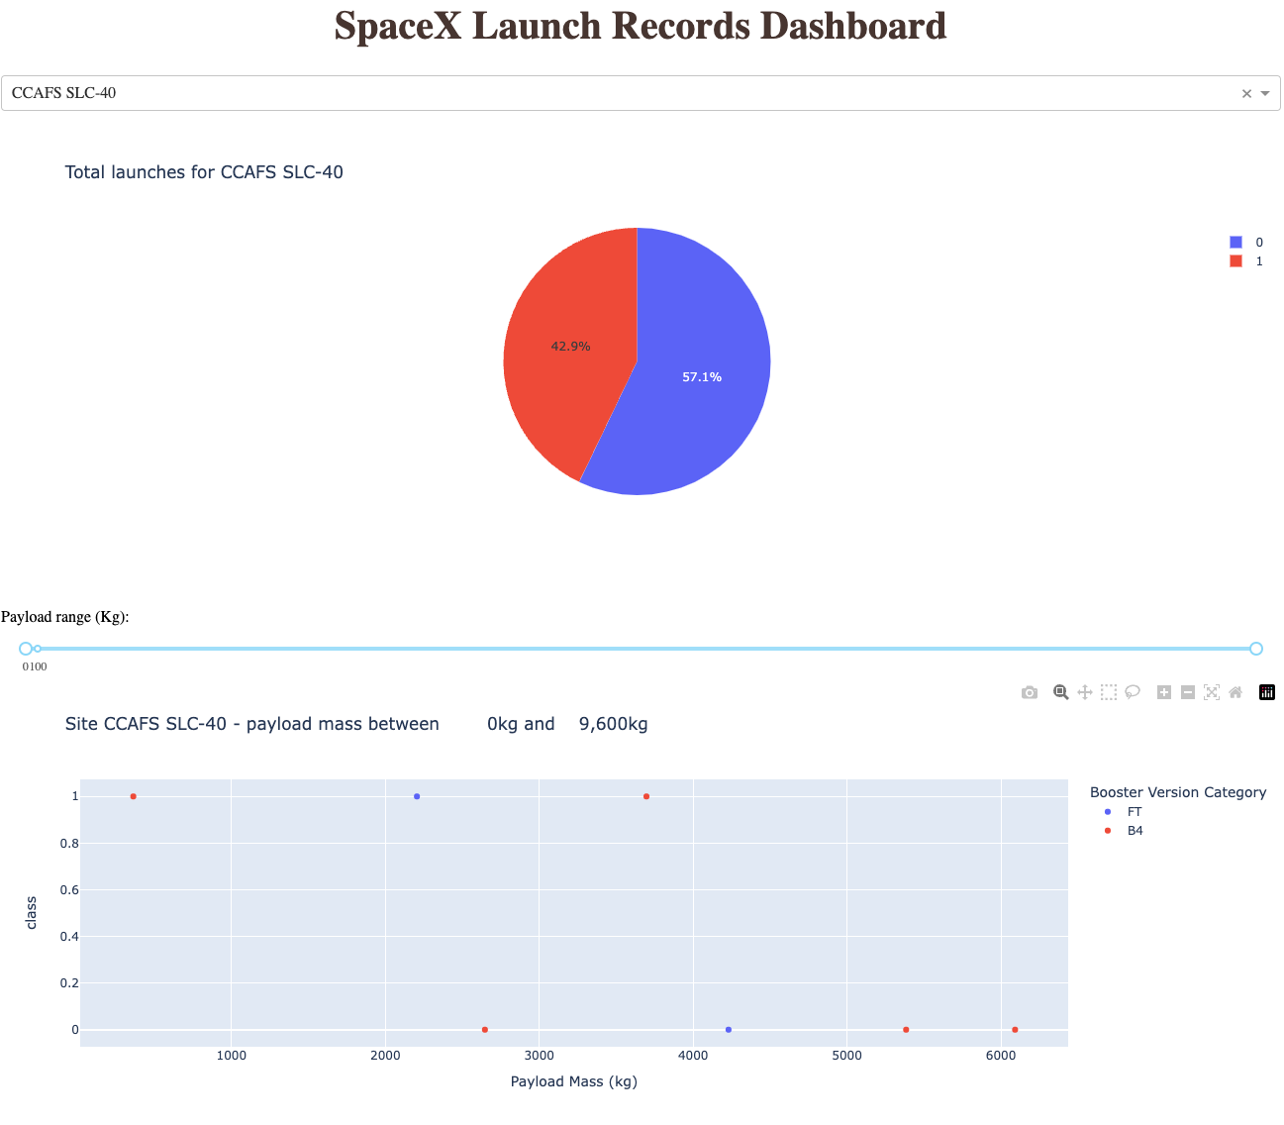
Interactive analytics demo

Slide 19
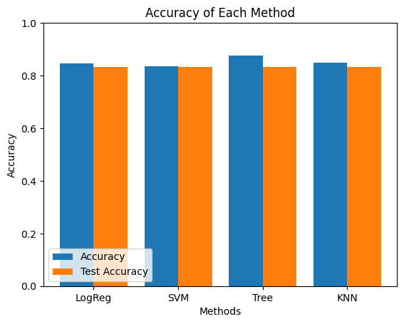
Predictive analysis results
Predictive Analysis showed that the Decision Tree Classifier is the best model to predict the successful landings with the training accuracy score of 87.7% accuracy, and the testing accuracy of 83.3%.

Slide 20

Section 2

Slide 21
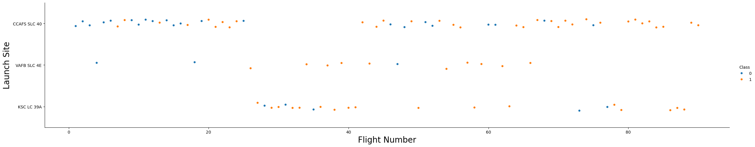
Flight Number vs. Launch Site
Most of the recent launches from CCAF5 SLC 40 have been successful.
The general success rates have been gradually improving overtime.
VAFB SLC 4E and KSC LC 39A share the second and third place in launch success, respectively.

Slide 22
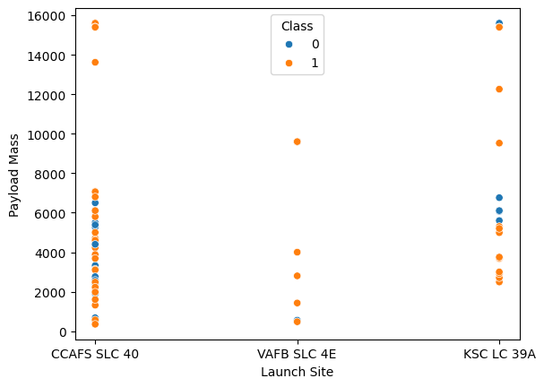
Payload vs. Launch Site
Payloads higher than 9000kgs have relatively higher success rates while the distribution is rather scattered with lesser payloads.
CCAFS SLC 40 and KSC LC 39A are the only launch sites that have data on payloads higher than 10000kgs.

Slide 23
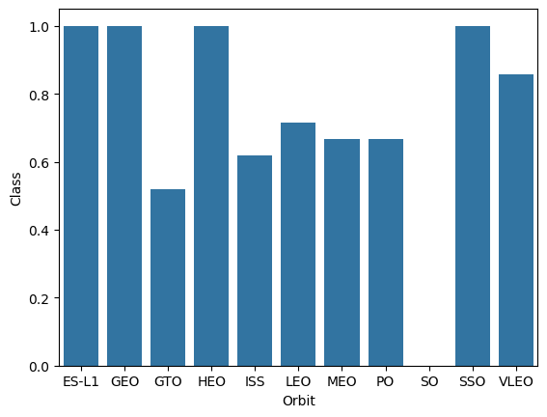
Success Rate vs. Orbit Type
Orbits with highest success rates:
ES-L1
GEO
HEO
SSO
VLEO
Orbits with lowest success rates:
MEO
PO
ISS
GTO
SO

Slide 24
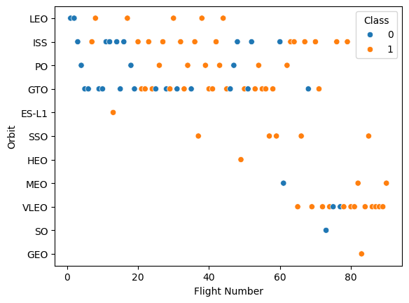
Flight Number vs. Orbit Type
Success rates improve over time for all orbit types.
Most recently the VLEO orbit has more frequent launches.
Launches to LEO seems to have dropped recently.

Slide 25
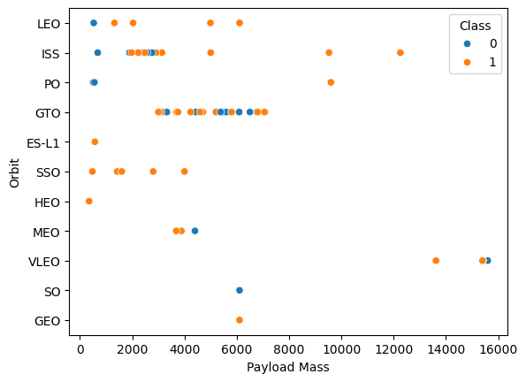
Payload vs. Orbit Type
Launch success to GTO is irrelevant to the payload mass.
Very few launches to SO, GEO, and LEO
Launches to ISS have the widest range of payload masses with relatively high success rate.

Slide 26
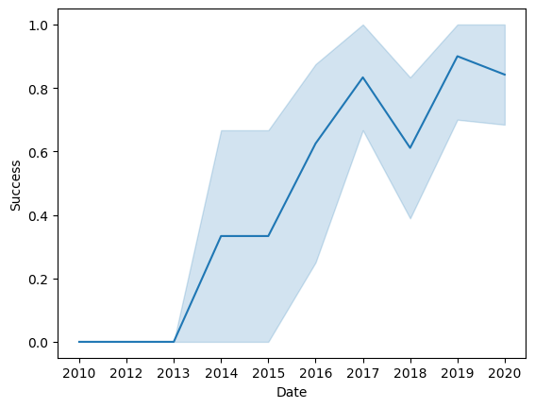
Launch Success Yearly Trend
Launch successes have greatly increased overtime.
Largest continuous increment in success rate happened between 2015 and 2017.

Slide 27
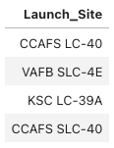
All Launch Site Names
Obtained selecting the unique occurrences of ‘Launch_Site’ values from the dataset, there are four launch sites:

Slide 28
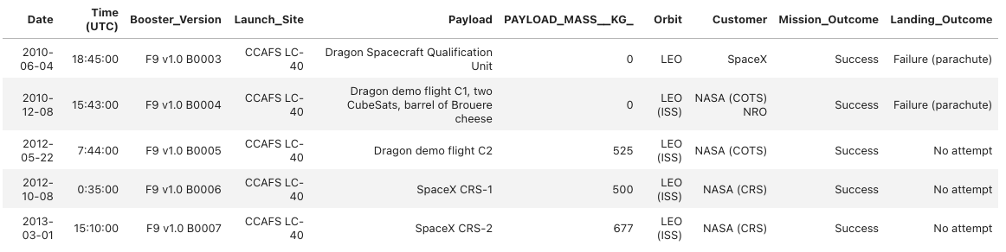
Launch Site Names Begin with 'CCA'
5 of the Cape Canaveral launch records (beginning with `CCA`) are as listed below:

Slide 29
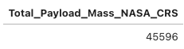
Total Payload Mass
Total payload carried by boosters from NASA (CRS):
The total payload mass above shows the sum of all payloads carried for NASA Commercial Resupply Services (CRS). The mass totaled to 45,596 kg.

Slide 30
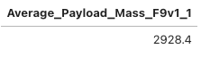
Average Payload Mass by F9 v1.1
Average payload mass carried by booster version F9 v1.1:
The average payload mass above shows the average of all payloads carried by the Falcon 9 v1.1 boosters. The average mass obtained was 2928.4 kg.

Slide 31
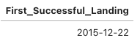
First Successful Ground Landing Date
Screenshot above shows the date of first successful landing outcome in ground pad. It was December 22, 2015. It was obtained querying for the minimum date value for the desired landing outcome.

Slide 32
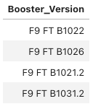
Successful Drone Ship Landing with Payload between 4000 and 6000
Boosters which have successfully landed on drone ship and had payload mass between 4000 and 6000 kg:
We obtained 4 results based on the given filters. The results included 4 Falcon 9 Full Thrust B1 series boosters.

Slide 33
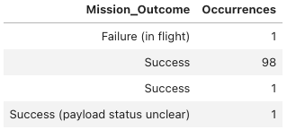
Total Number of Successful and Failure Mission Outcomes
Total number of successful and failure mission outcomes
Above screenshot shows the outcomes of the mission with 99 successes, 1 failure and 1 success with unclear payload status. It was obtained grouping the count records for individual mission outcome type.

Slide 34
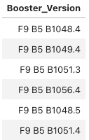
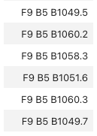
Boosters Carried Maximum Payload
Boosters which have carried the maximum payload mass:

Slide 35
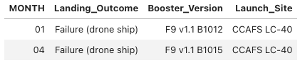
2015 Launch Records
Failed landing_outcomes in drone ship, their booster versions, and launch site names for months in year 2015:
From the list above, we can see that there were only two failed landing outcomes in drone ship from the Cape Canaveral launch site in January and April of 2015. The failures occurred with the Falcon 9 v1.1 B1 boosters.

Slide 36
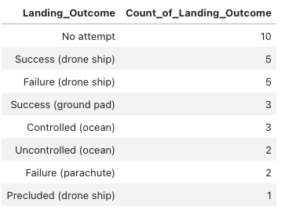
Rank Landing Outcomes Between 2010-06-04 and 2017-03-20
Ranking the count of landing outcomes between the date 2010-06-04 and 2017-03-20, in descending order,
The significant number of Landing_Outcome with “No attempt” could be rather concerning as it constitutes of about 33% of the records.

Slide 37

Section 3

Slide 38
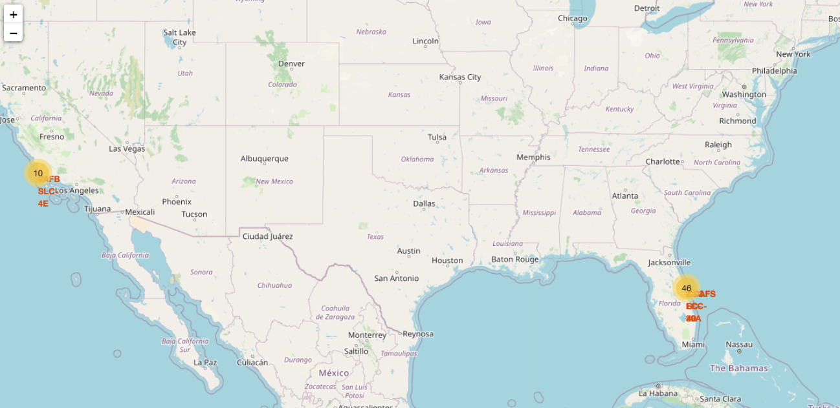
Launch Sites
The launch sites are strategically located near large water masses (the Atlantic and Pacific oceans), but within reach of major highways and/or railroads providing adequate infrastructural support and availability.

Slide 39
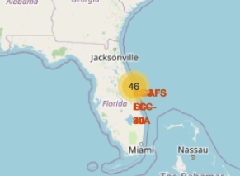
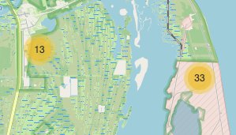
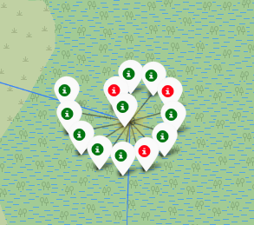
Labelled Launch Records - Geolocated
Here, we can see the concentration of launch sites by the water masses with majority of them in the east coast (46). The green markers depict successful launches and the red show failure in the KSC LC-39A launch site.

Slide 40
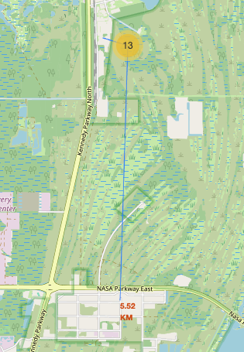
Safety and Access to Infrastructure
The map shows the distance from the population areas and access to infrastructures such as railroad, highways and ports.
It shows that the launch sites are close to the infrastructural access points, while being decently spaced from major population areas.
The spacing ensures access and support, while ensuring safety.

Slide 41

Section 4

Slide 42
Launch Success Metrics Dashboards
The adjacent dashboard shows a pic chart with success rates for all launch sites, with a corresponding scatterplot at the bottom.
It depicts the launch successes with site KSC LC-39A being the most successful launch site accounting for 41.7% of all the successful launches.

Slide 43
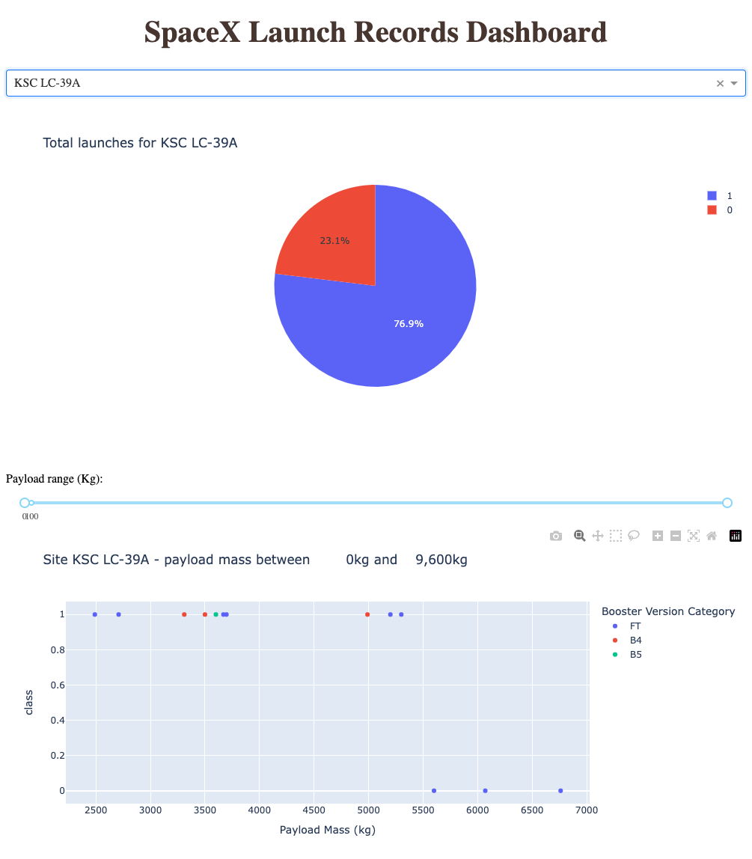
KSC LC-39A Launch Outcomes
The adjacent screenshot shows a pie chart depicting success rate for the Kennedy Space Center Launch Complex 39 A in Florida, with a corresponding scatterplot classified by the booster versions used.
The piechart shows a success rate of 76.9% vs 23.1% failures. This is the highest success rate of all the launch sites.

Slide 44
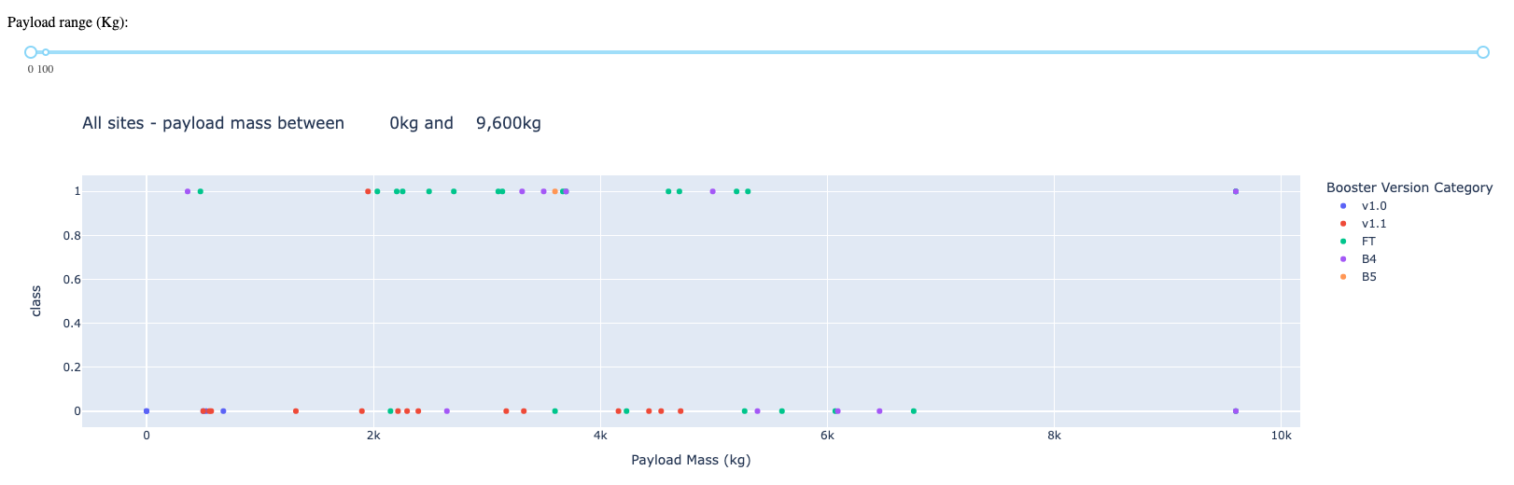
Payload vs. Launch Outcome
The screenshot of the dashboard above shows screenshot of Payload vs. Launch Outcome scatter plot for all sites, with different payload ranges from 0kg to 9,600kg.
It can be observed that the Full Thrust (FT) boosters are the most successful with payload mass between 2,000kg and 6,000kg.

Slide 45

Section 5

Slide 46
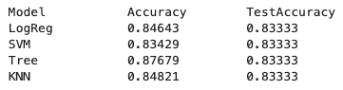
Classification Accuracy
After train-test split, four classification models were built and tested for accuracy; Logistic Regression, Support Vector Machine, Decision Tree Classifier, and K-Nearest Neighbors.
The best performing classification model was picked based on the accuracy score of each model.
The adjacent bar-chart shows the Classification Models vs. Accuracy with a corresponding value chart below.
The Decision Tree Classifier is the best model to predict the successful landings with the training accuracy score of 87.7% accuracy, and the testing accuracy of 83.3%.

Slide 47
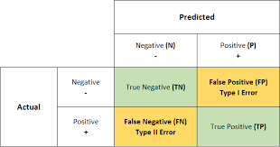


Confusion Matrix : Decision Tree Classifier
The confusion matrices, below, of the Decision Tree Classifier show that the training dataset has a proportionally large predicted True-positive values, leading to a better accuracy score.
Confusion Matrix – Training Set
Confusion Matrix – Testing Set

Slide 48
Conclusions
Analysis, refinement, classification, and prediction of the available dataset helped conclude the following:
The best launch site, in terms of launch successes: KSC LC-39A (Kennedy Space Center – Launch Complex 39A)
Launch success rates are higher for larger payloads (>6000kg)
Launch and land successes are improving significantly over time.
With large enough dataset, the success/failure of a mission could be reasonably predicted to make better informed decisions.

Slide 49


